Slide 1
Effect of predictor variables on CGRP_Coverage

Slide 2
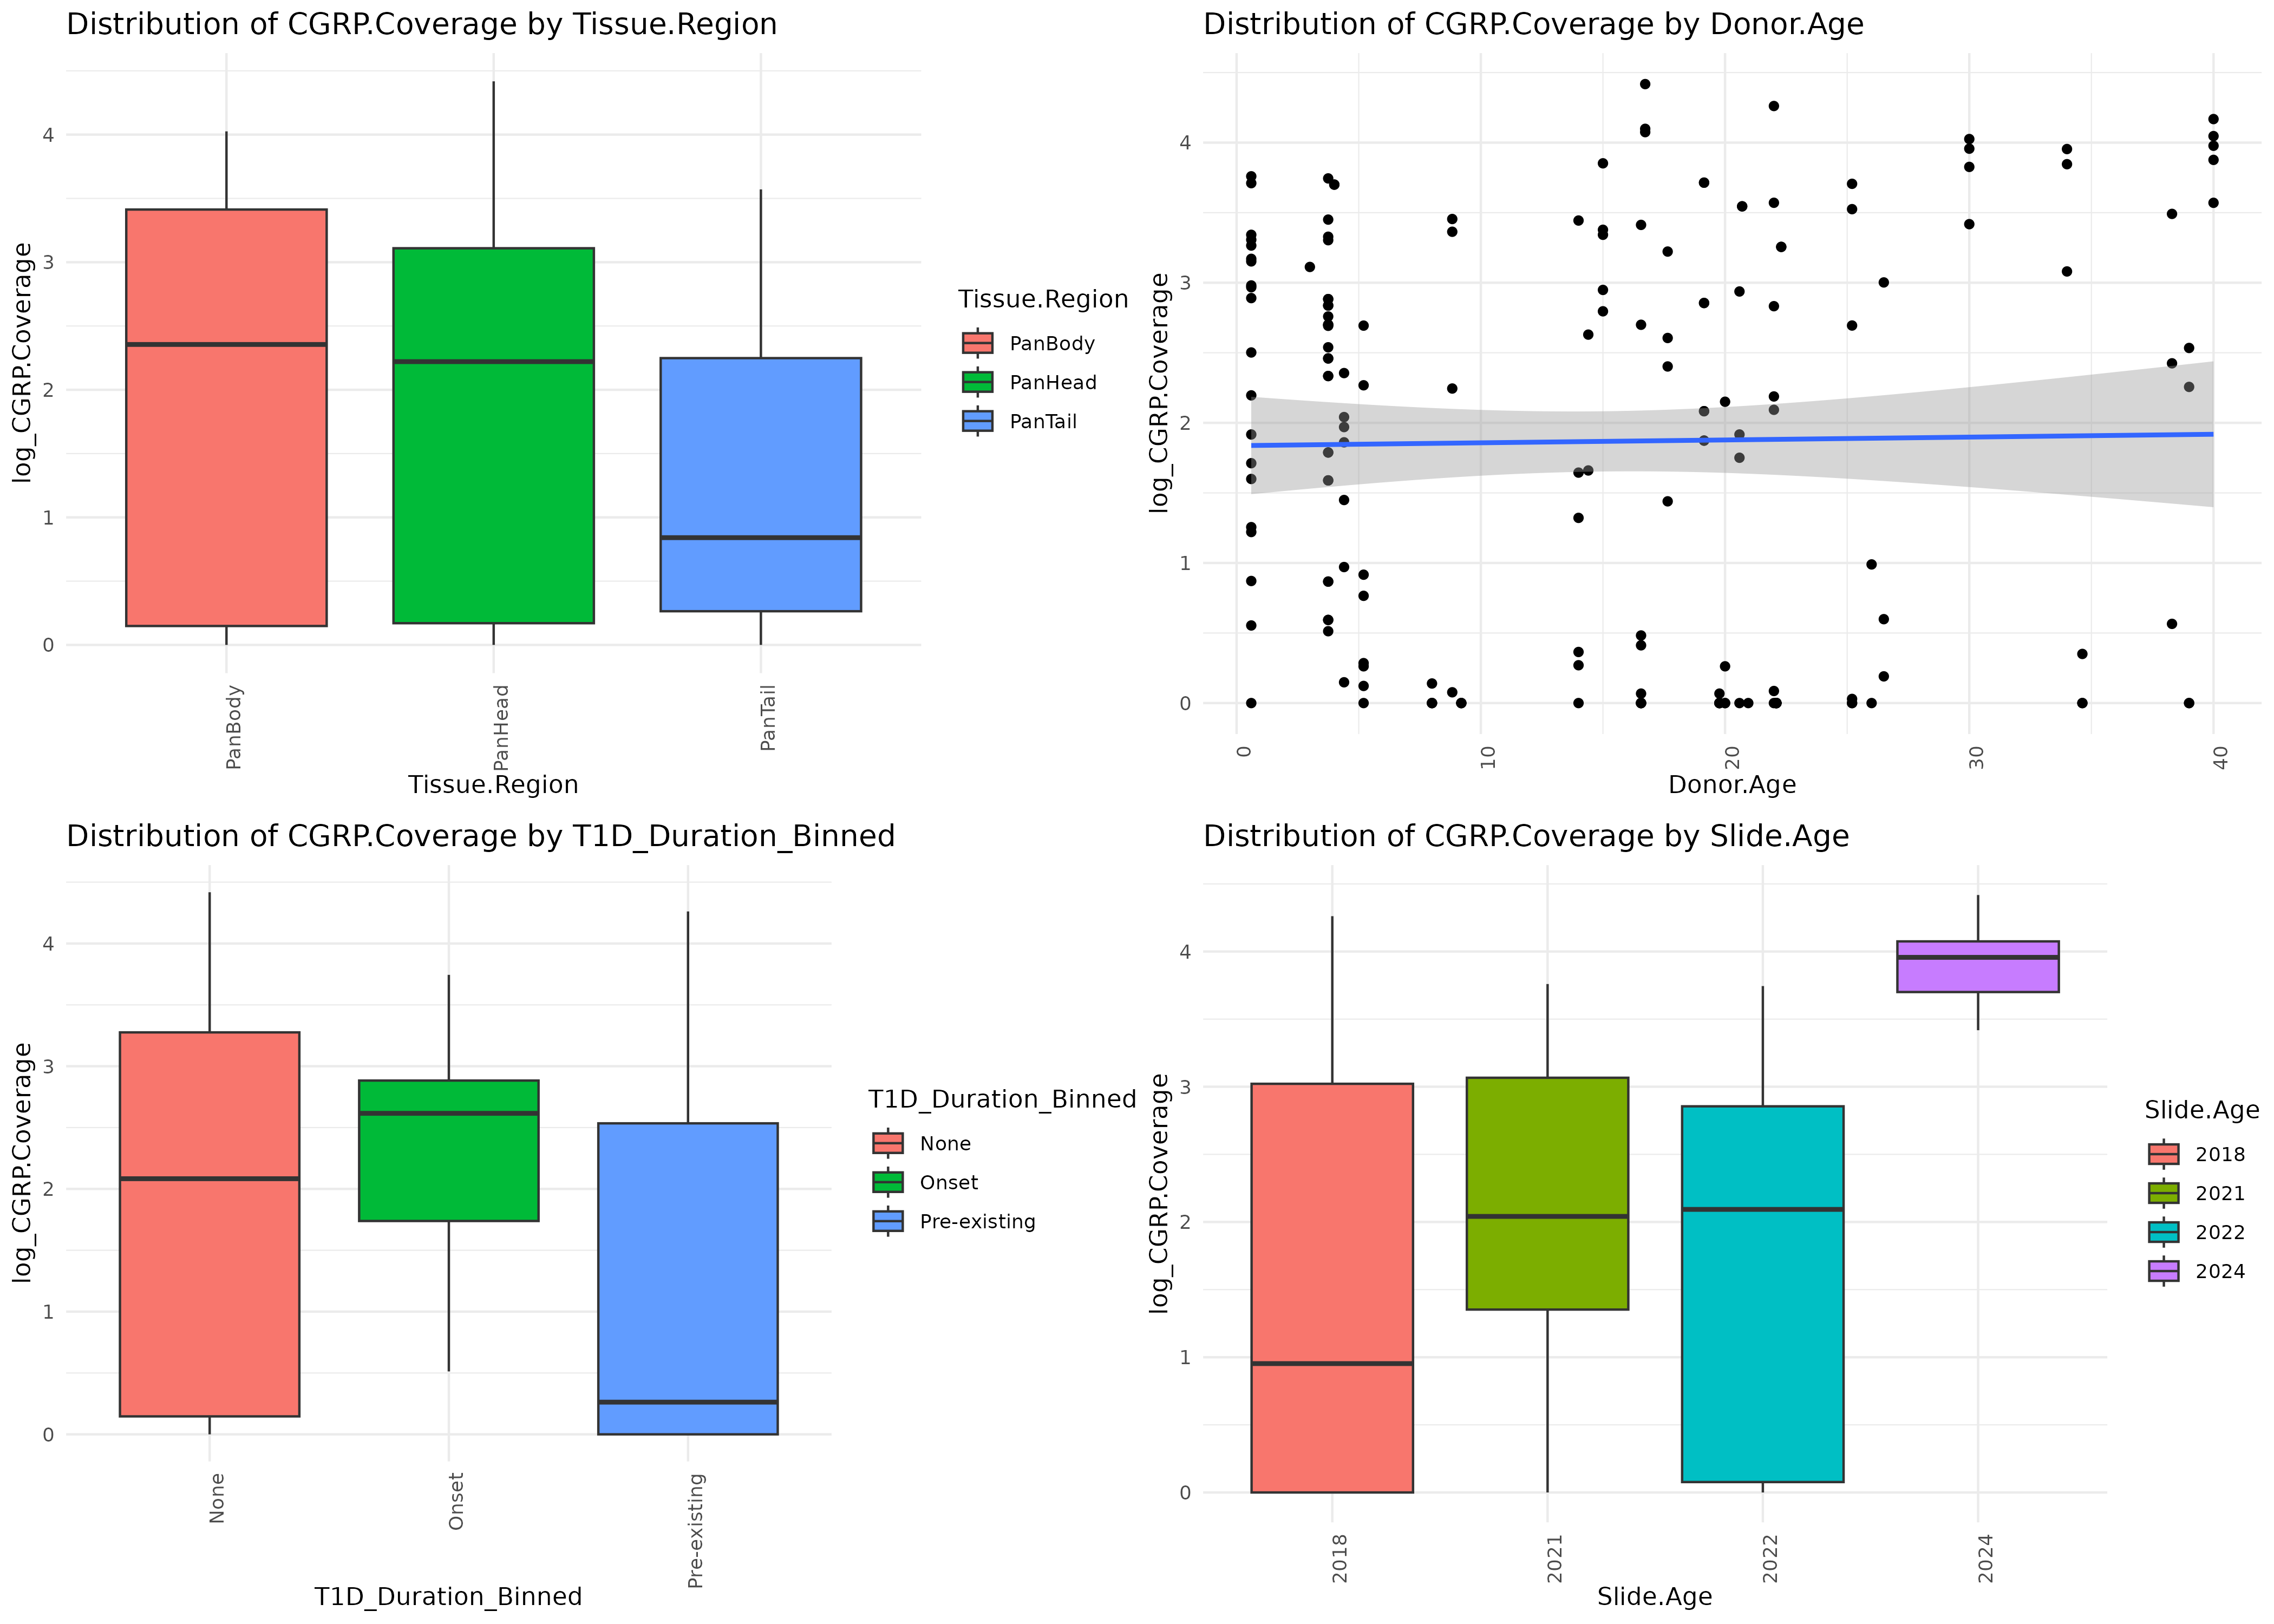

Slide 3
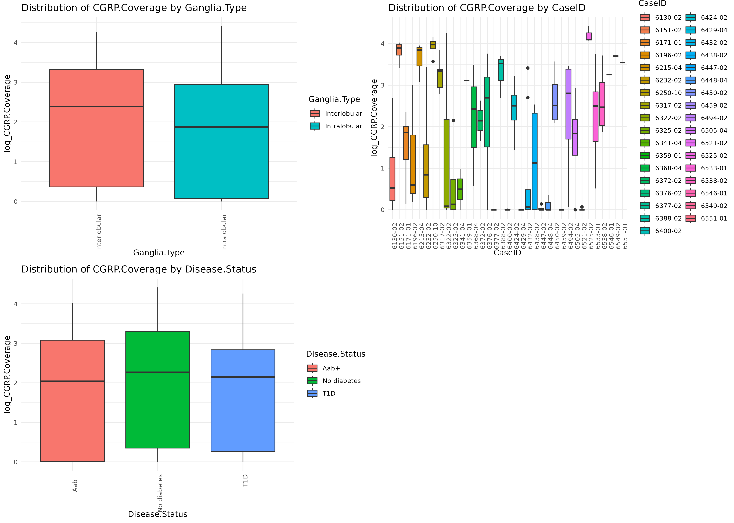

Slide 4
Effect of predictor variables on ChAT_Coverage

Slide 5
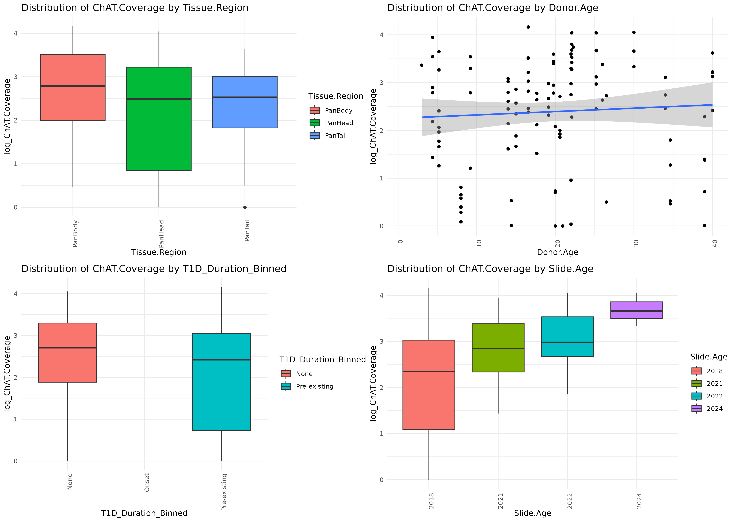

Slide 6
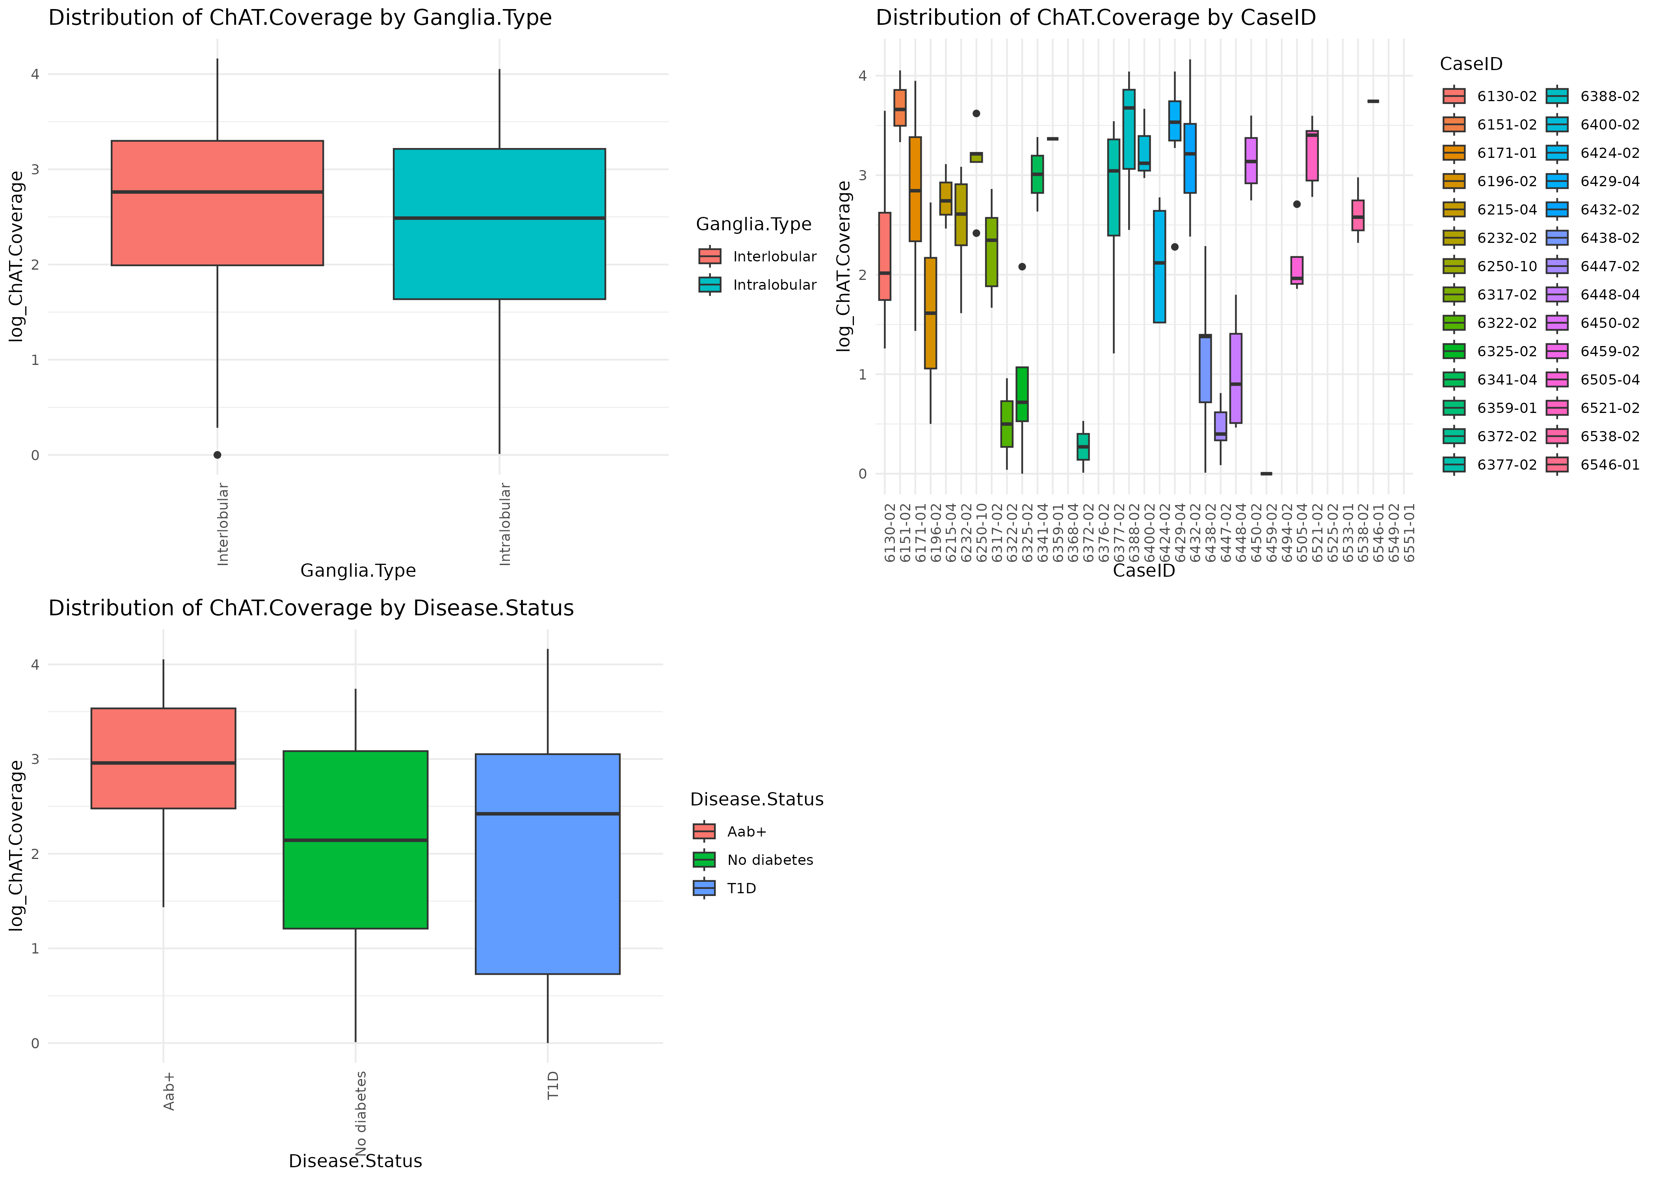

Slide 7
Effect of predictor variables on Ganglia_Area_um_2_

Slide 8
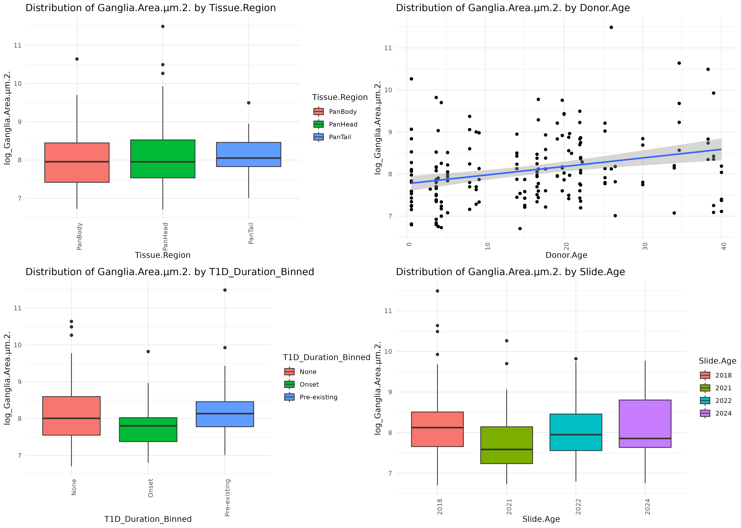

Slide 9
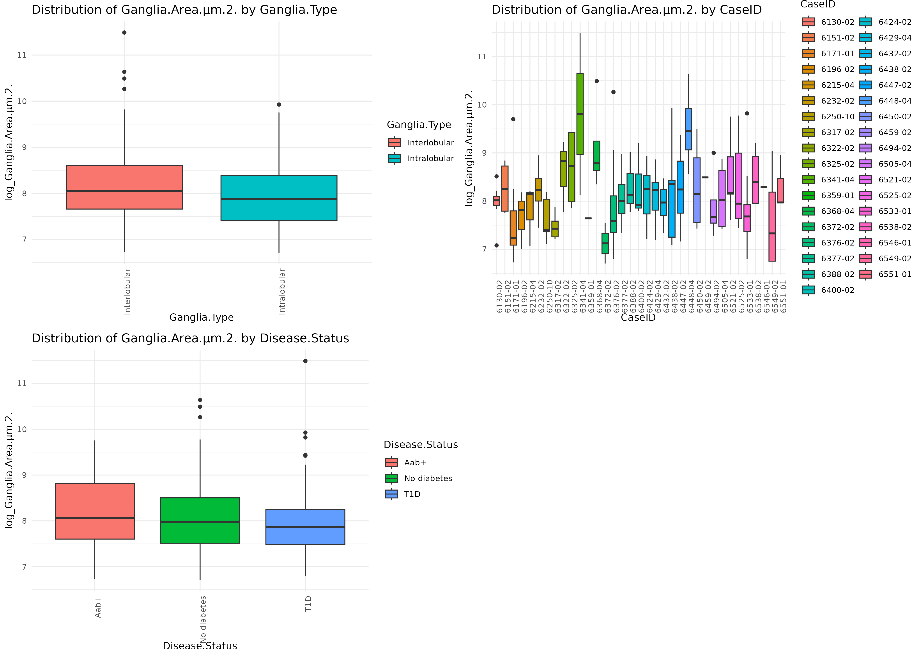

Slide 10
Effect of predictor variables on HuCD_Coverage

Slide 11
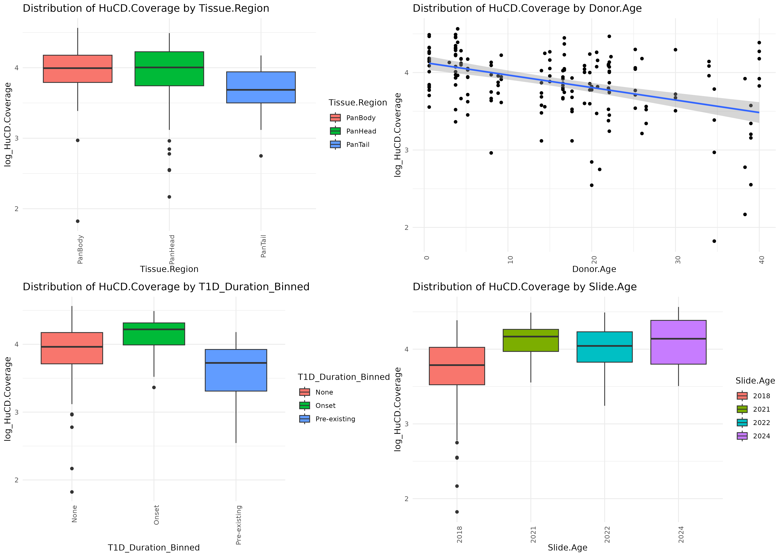

Slide 12
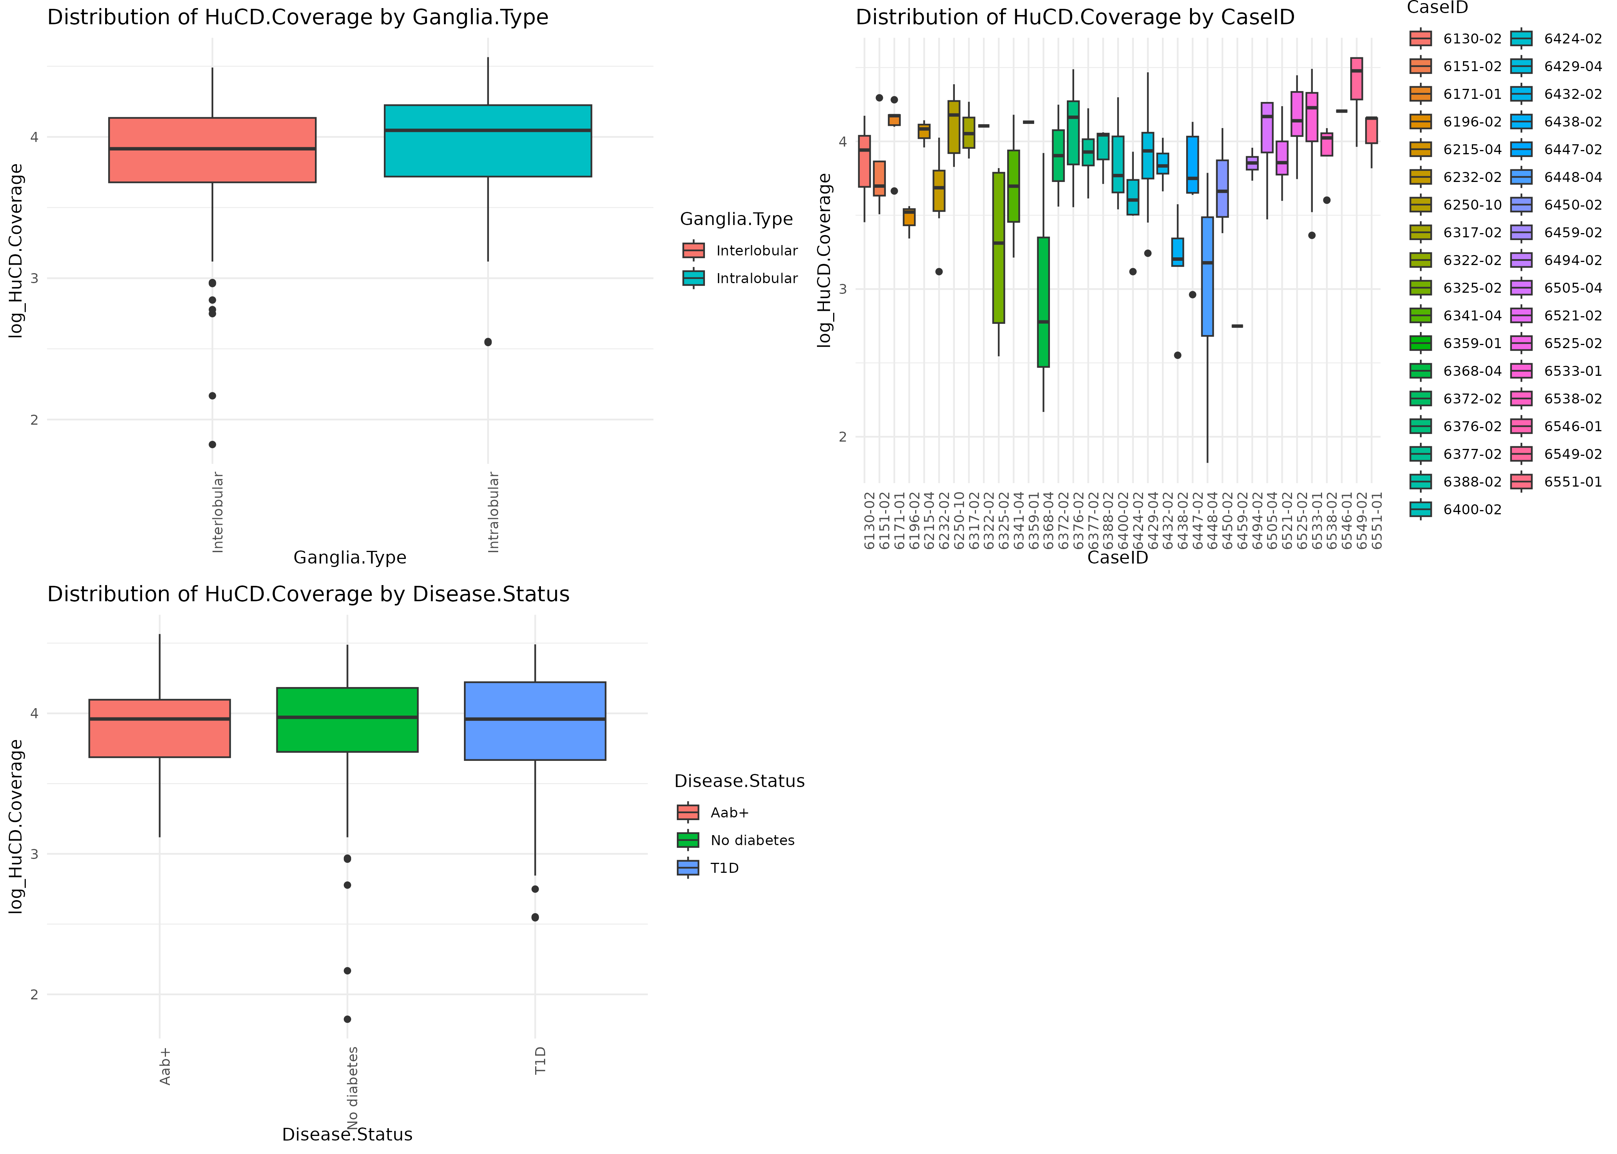

Slide 13
Effect of predictor variables on nNOS_Coverage

Slide 14
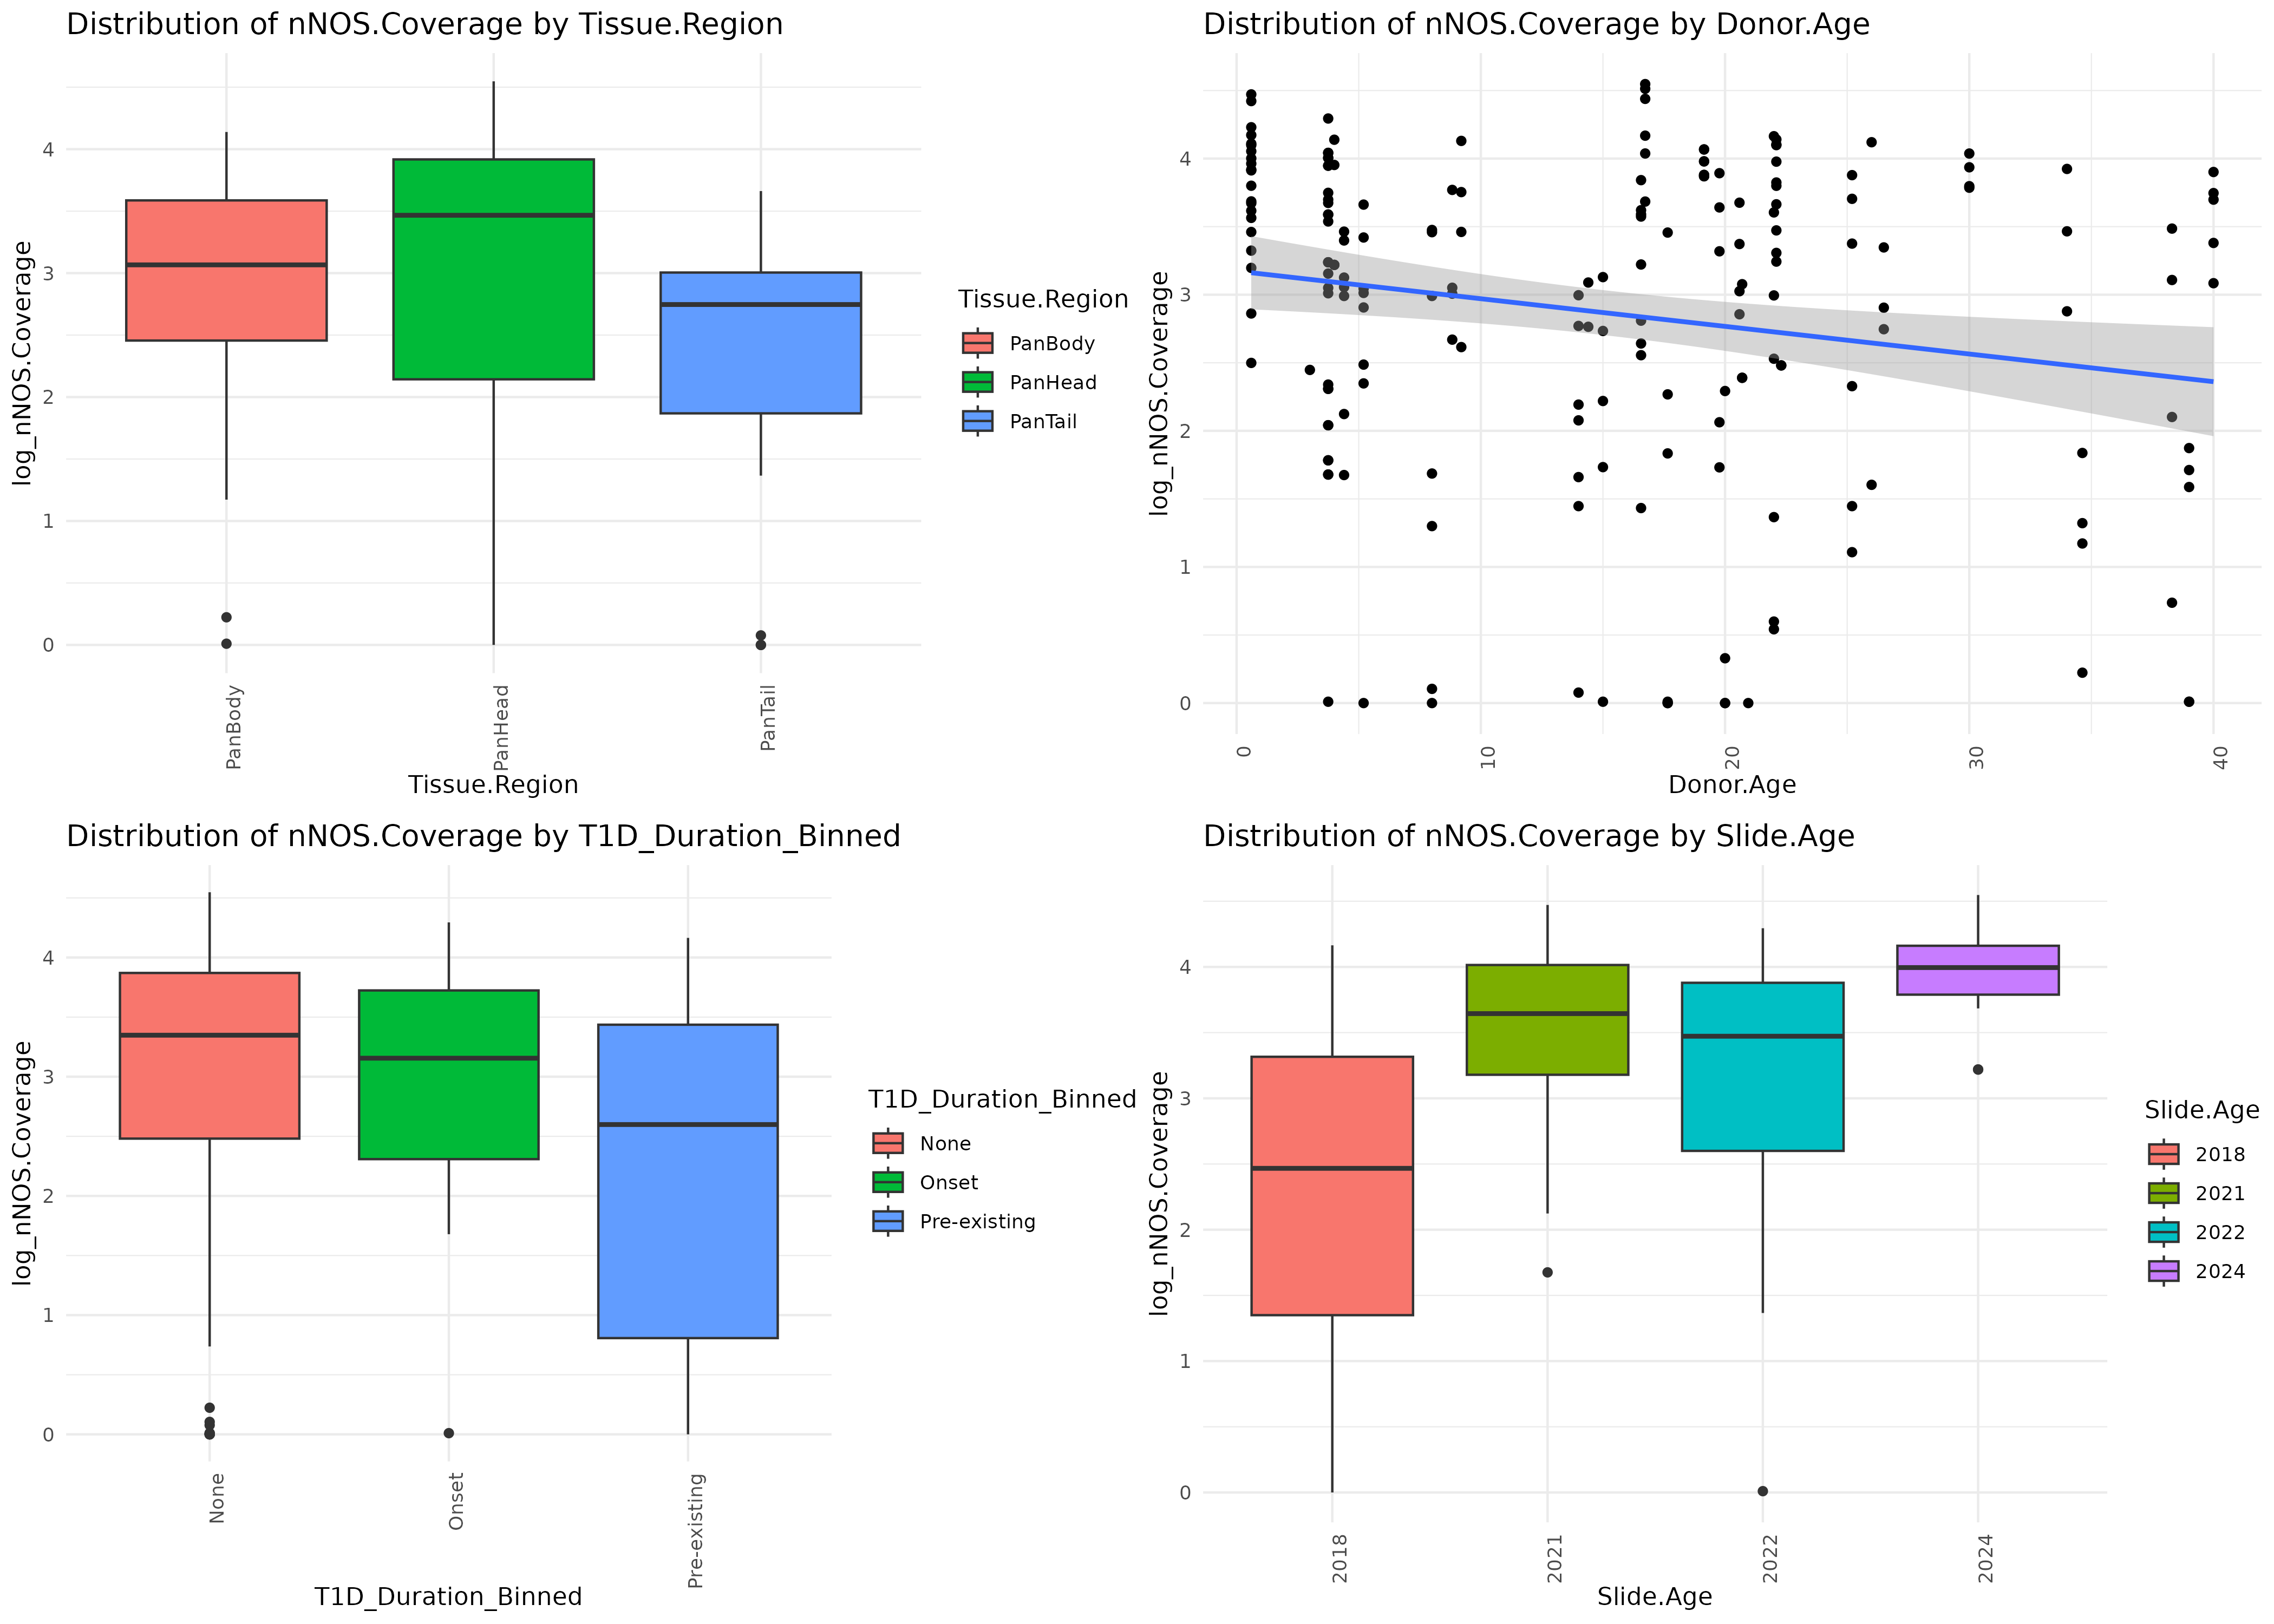

Slide 15
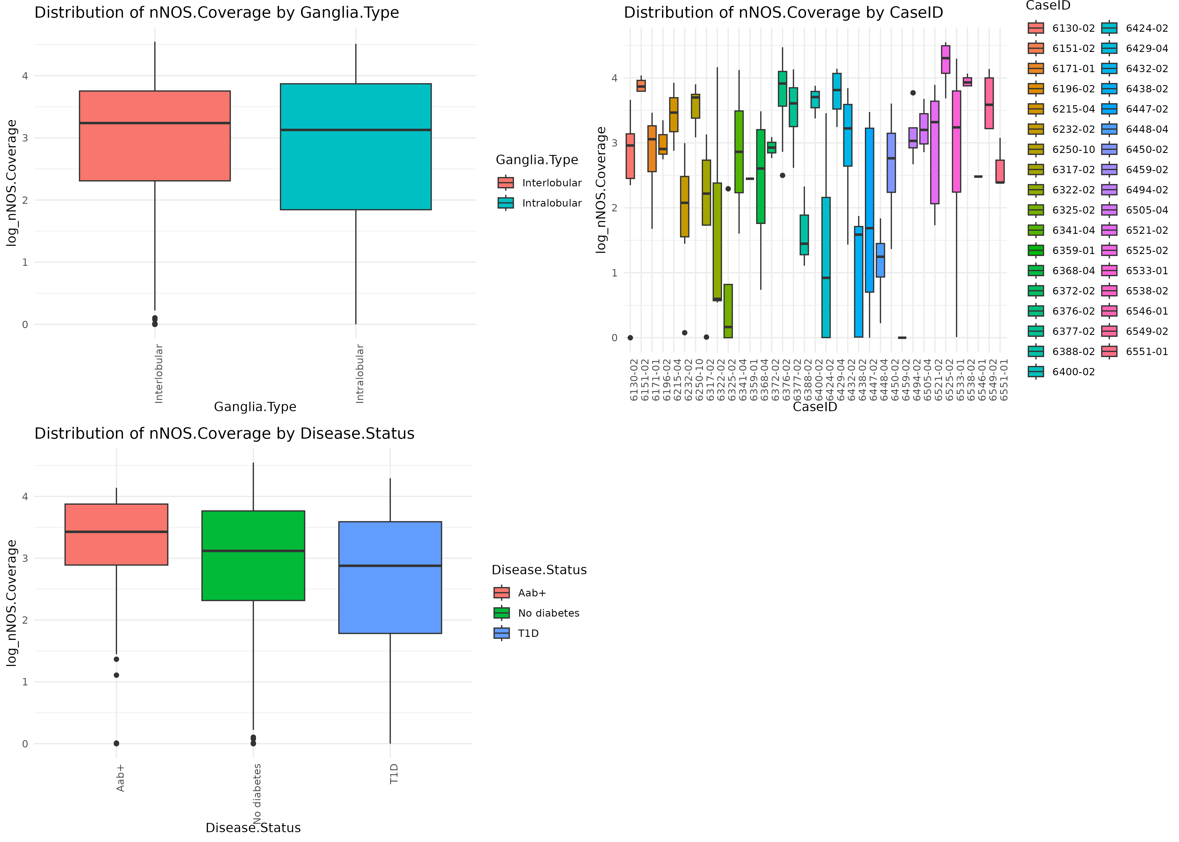

Slide 16
Effect of predictor variables on SNAP25_high_threshold_coverage

Slide 17
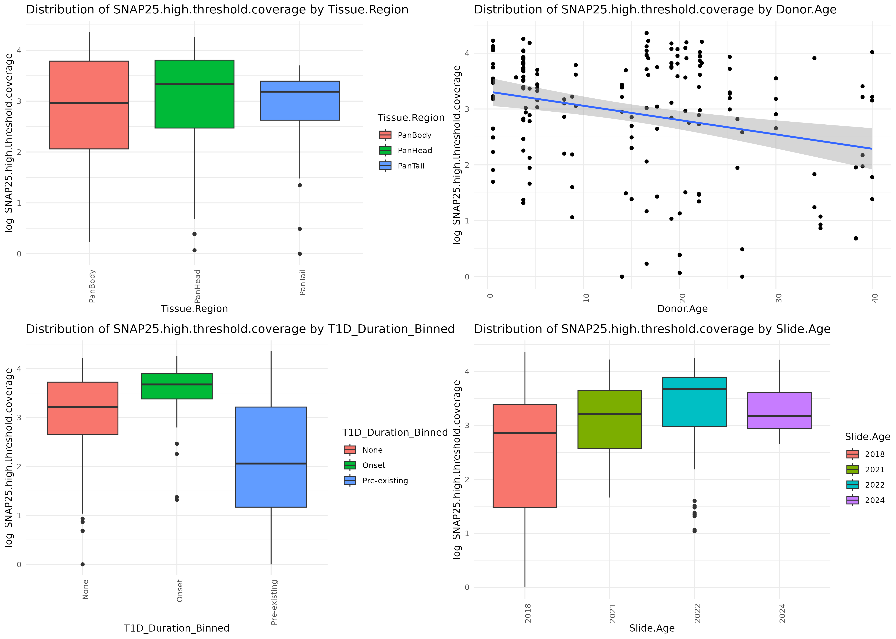

Slide 18
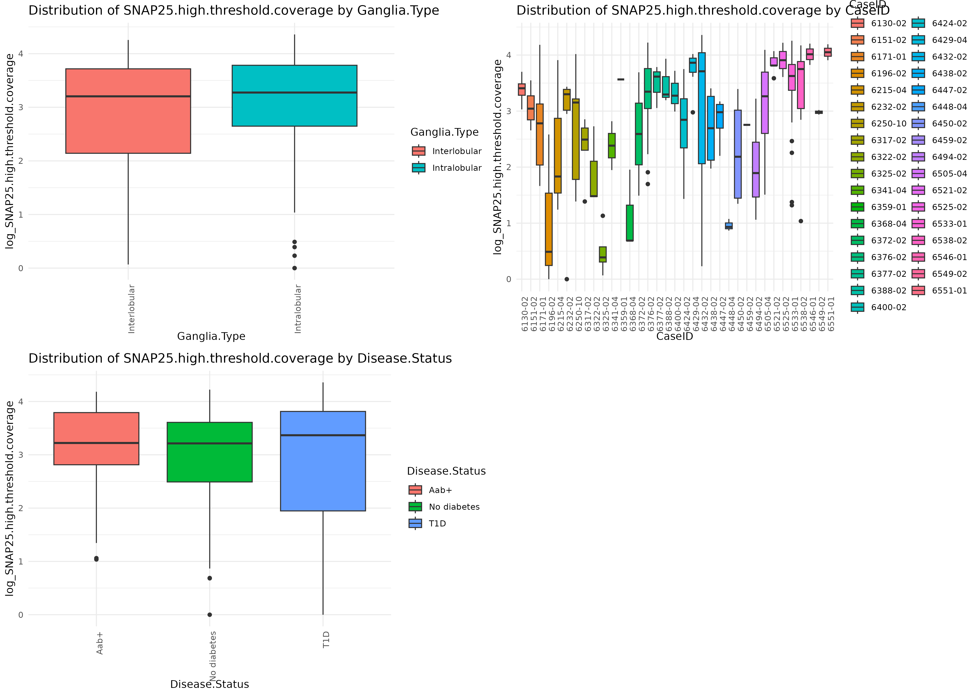

Slide 19
Effect of predictor variables on SNAP25_low_threshold_coverage

Slide 20
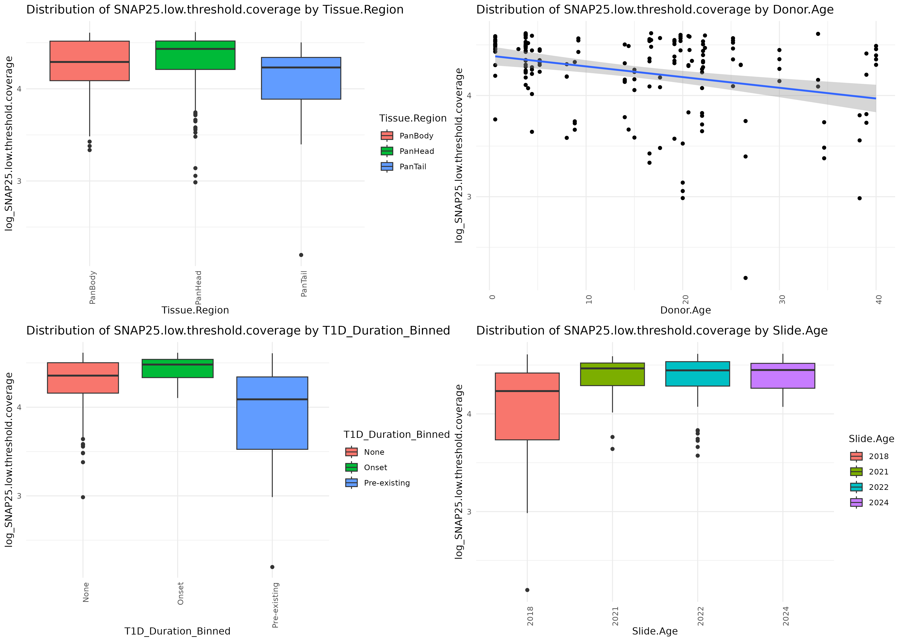

Slide 21
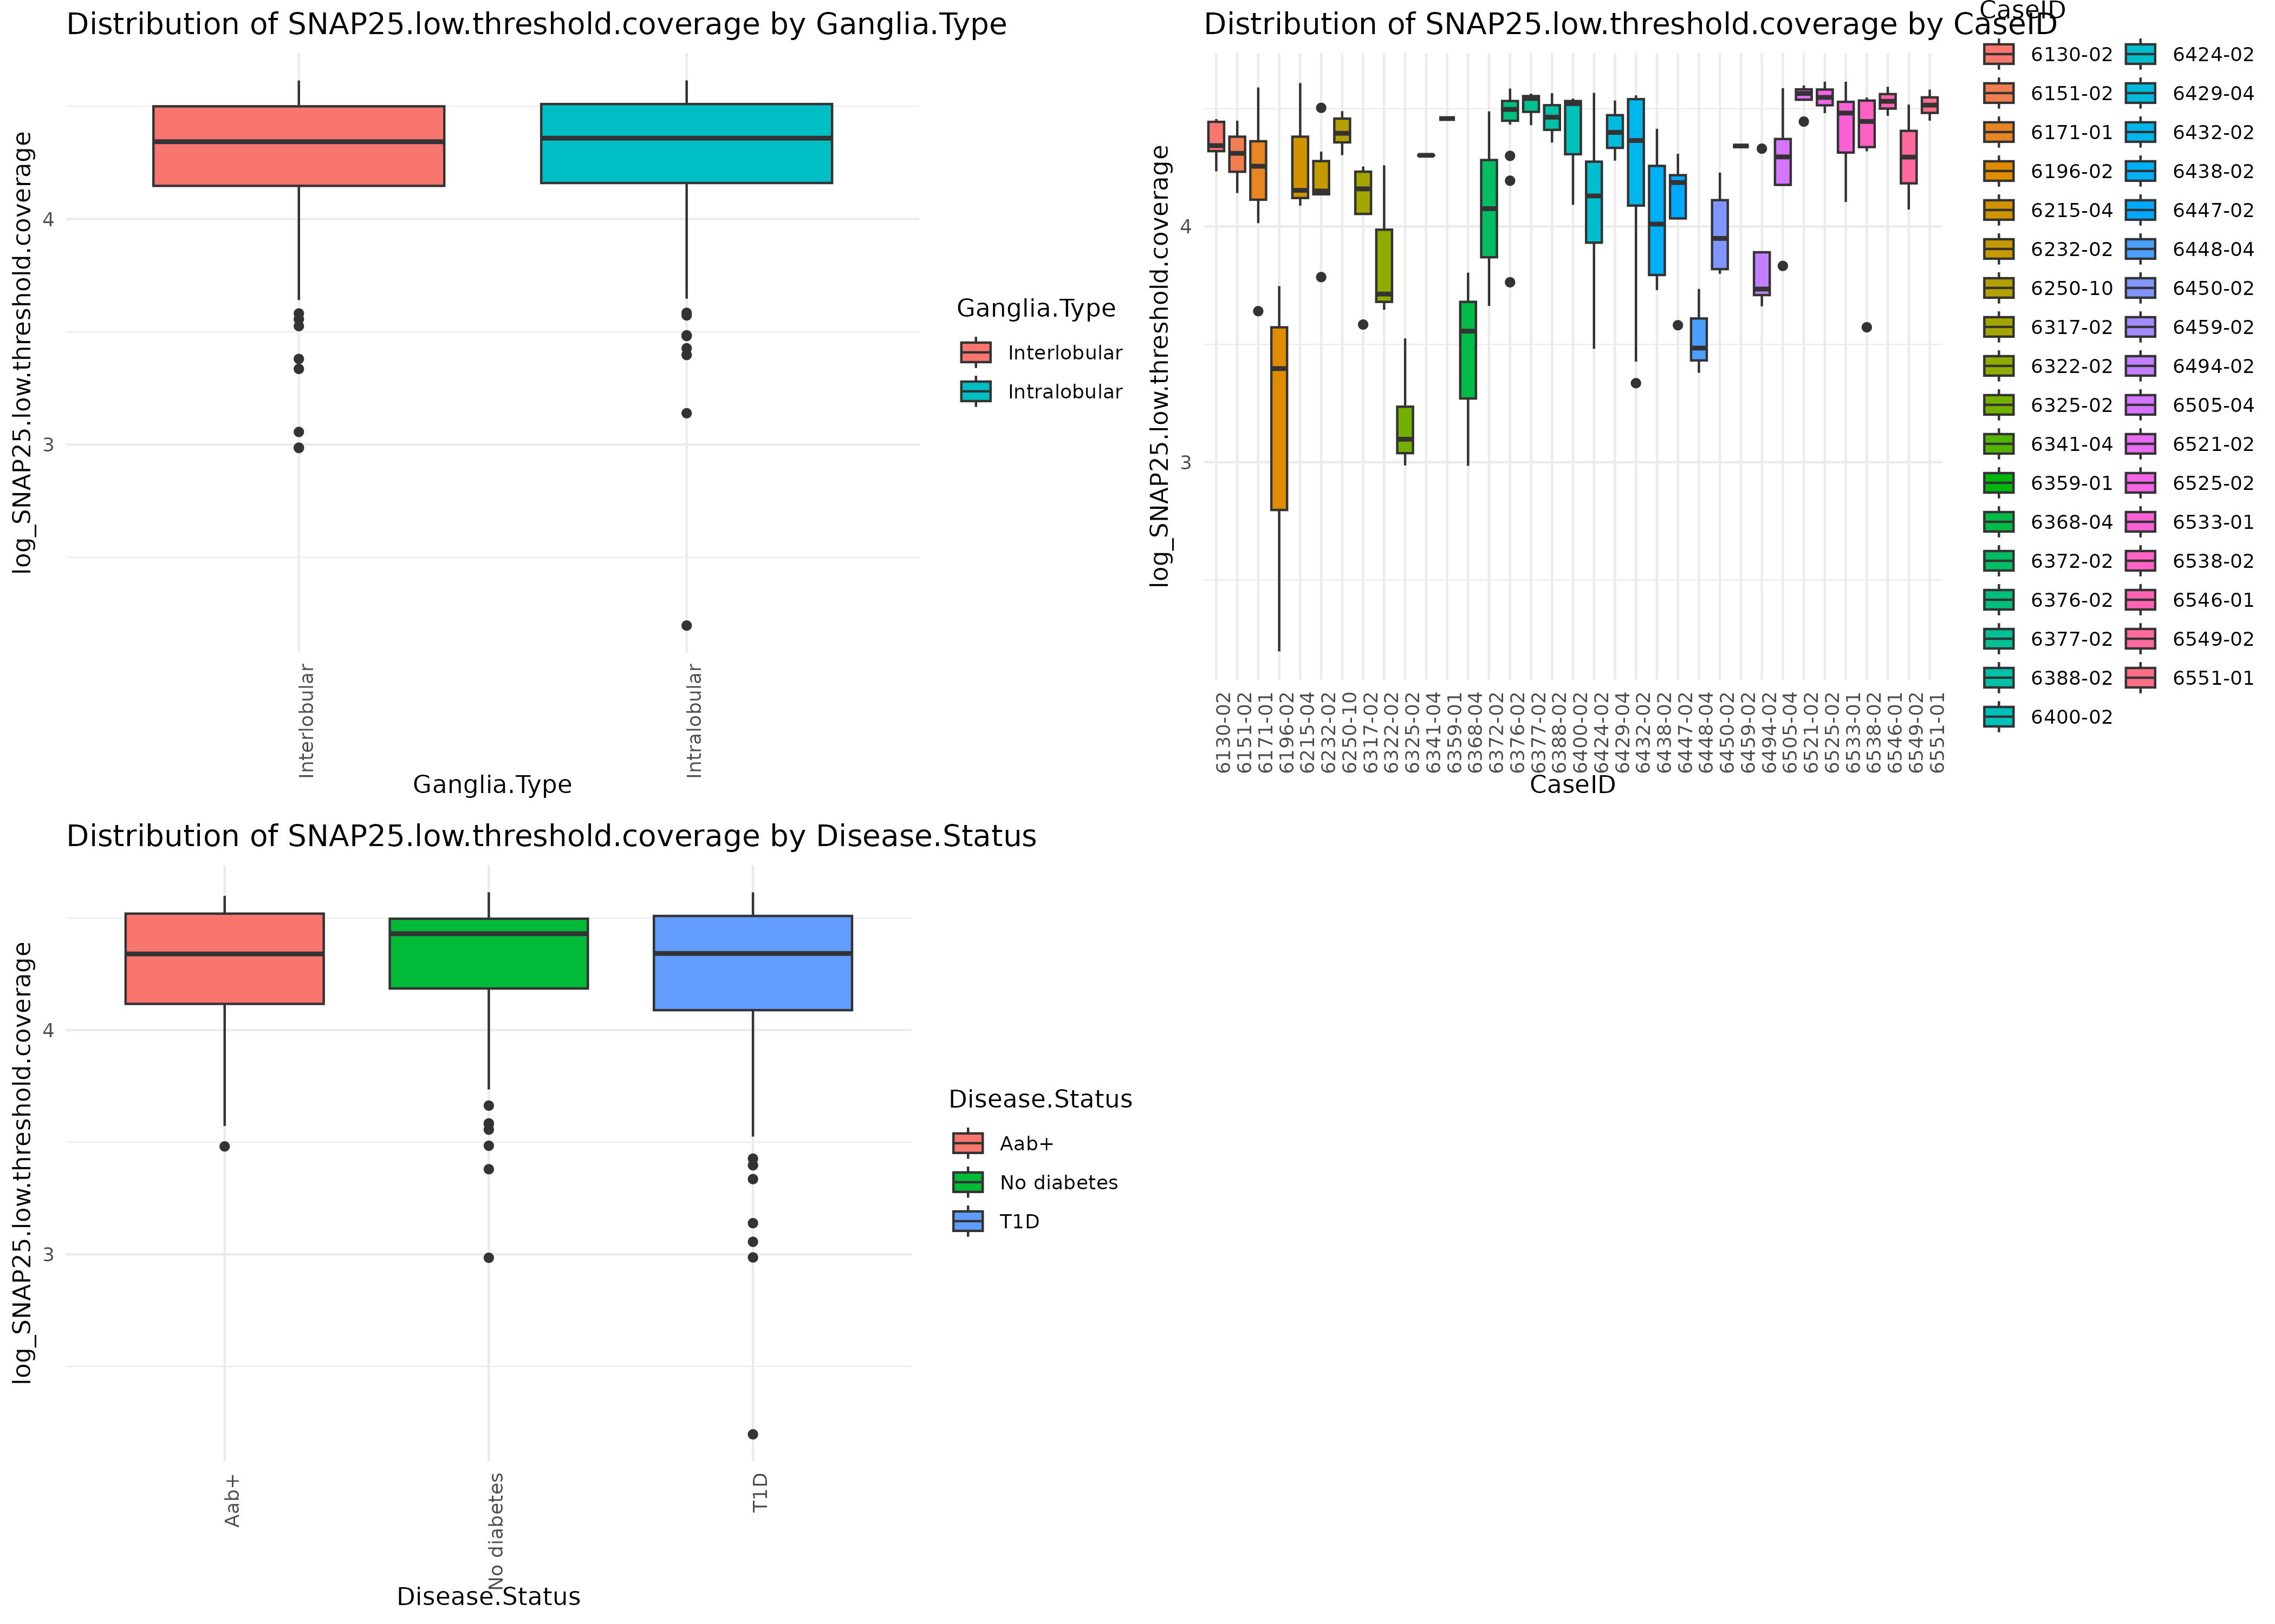

Slide 22
Effect of predictor variables on SubP_Coverage

Slide 23
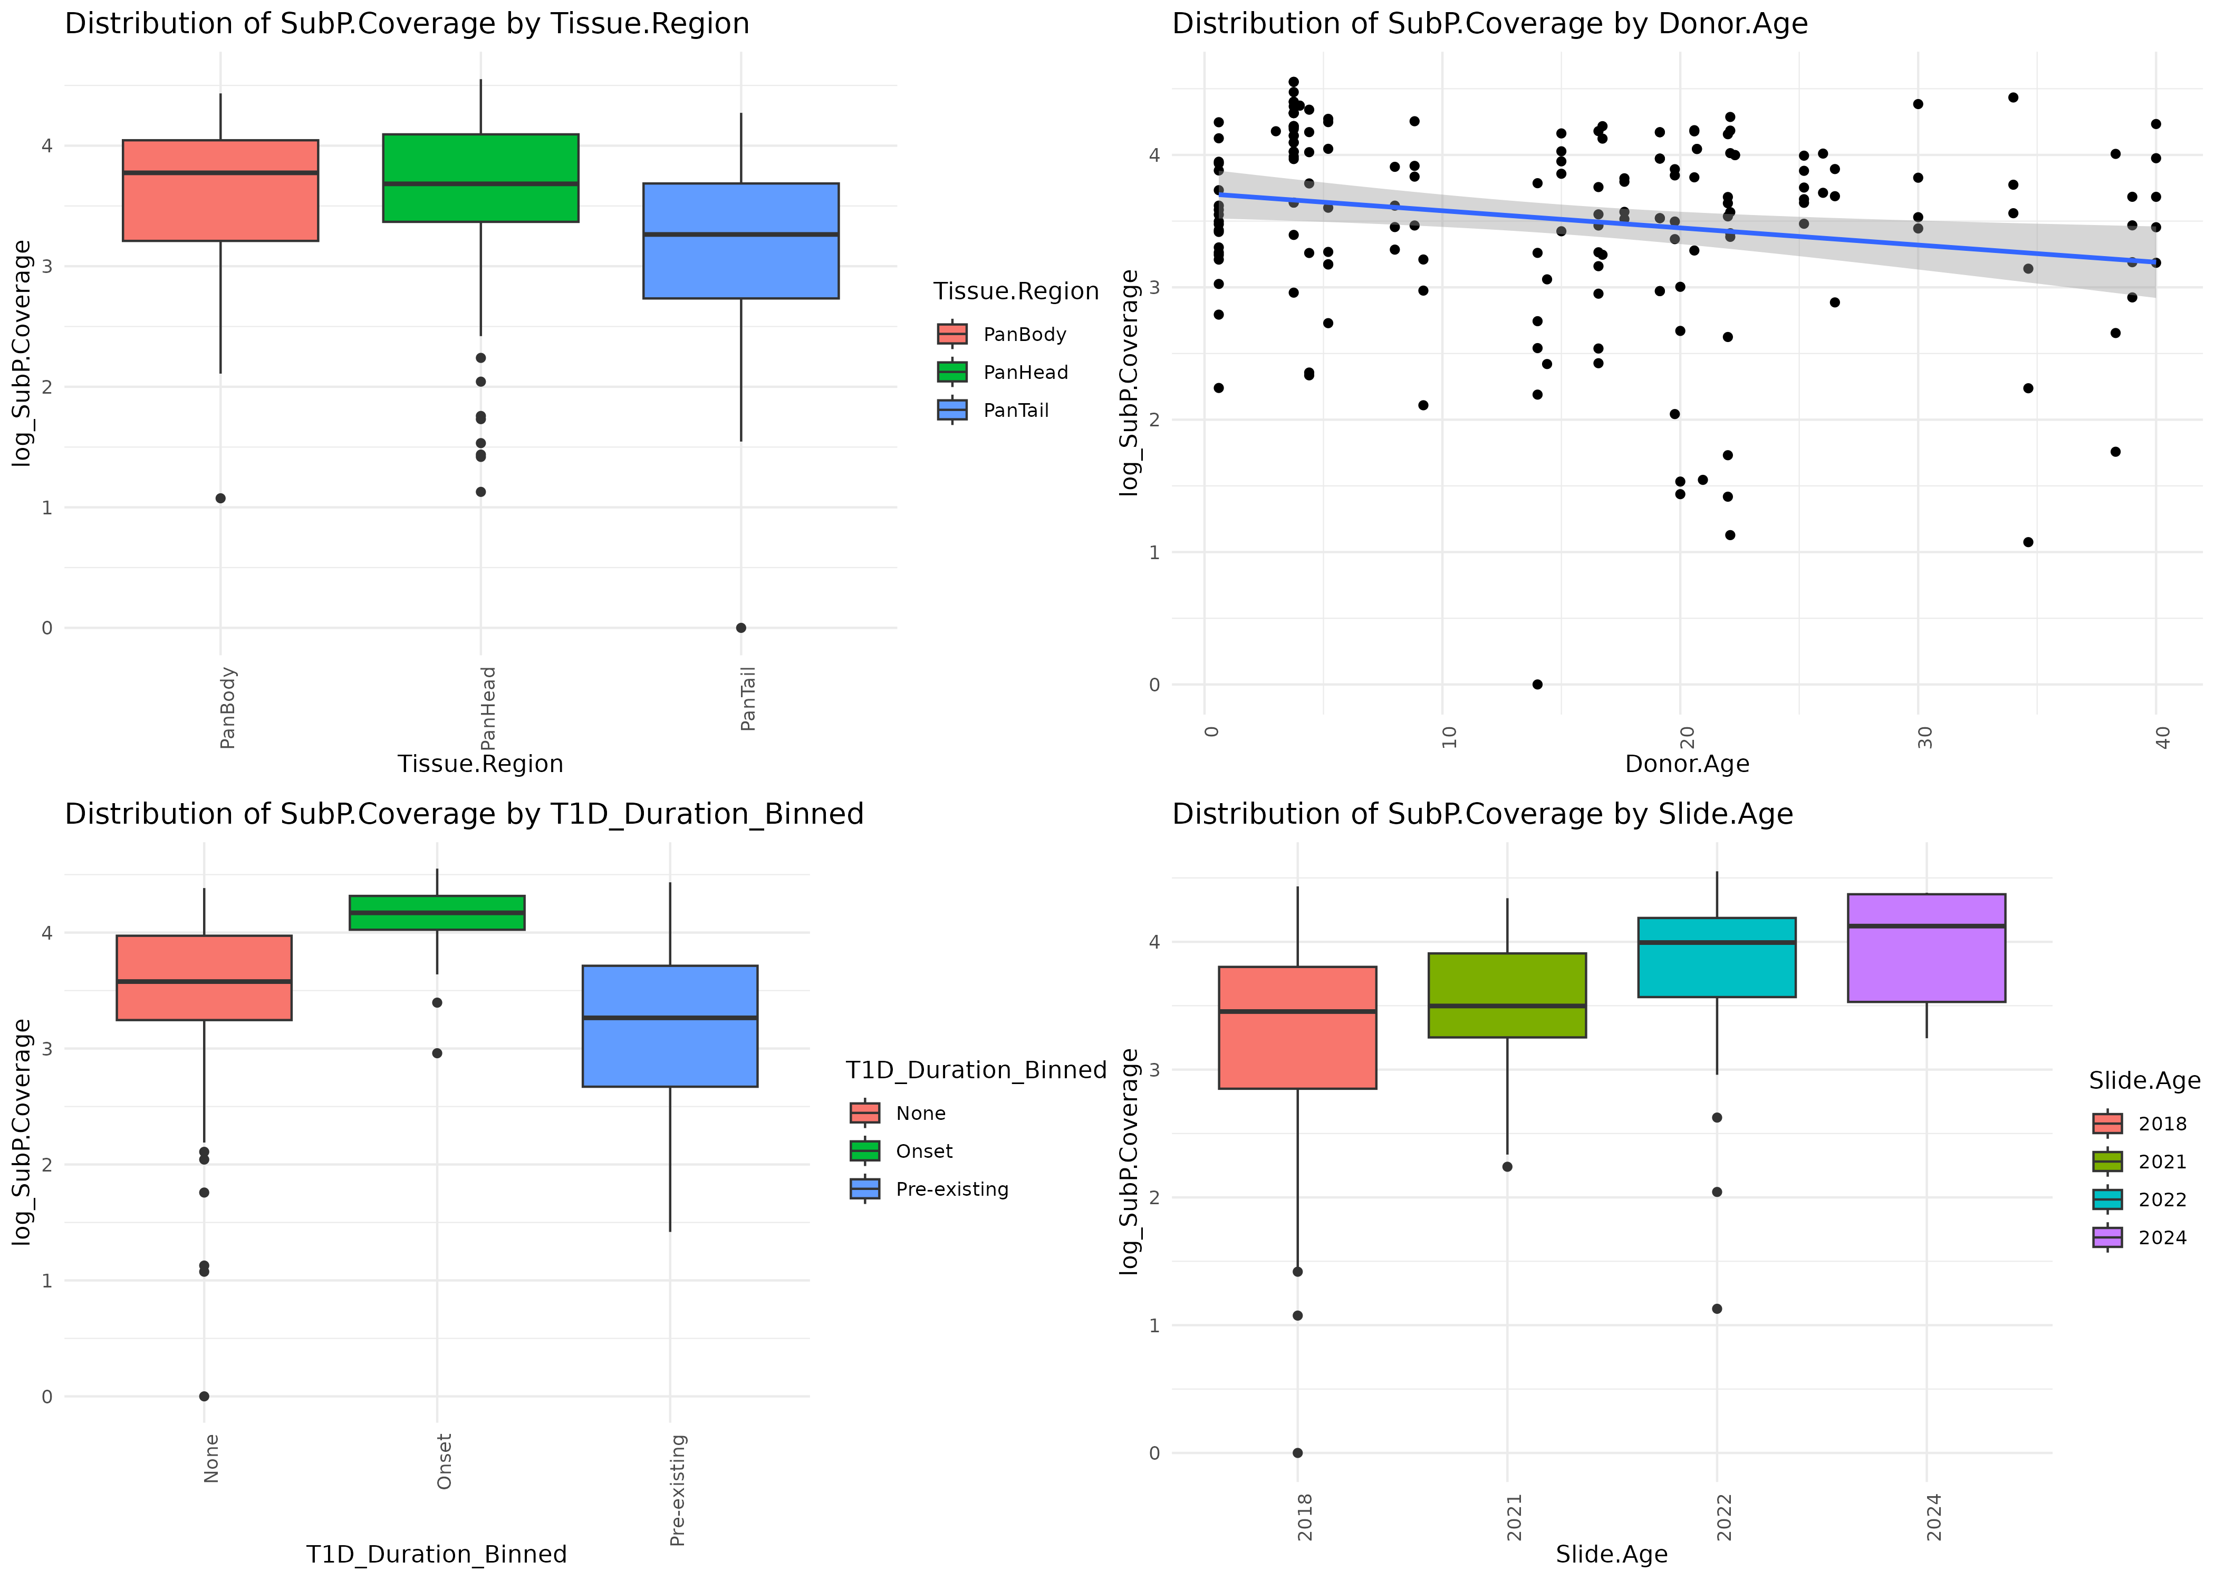

Slide 24
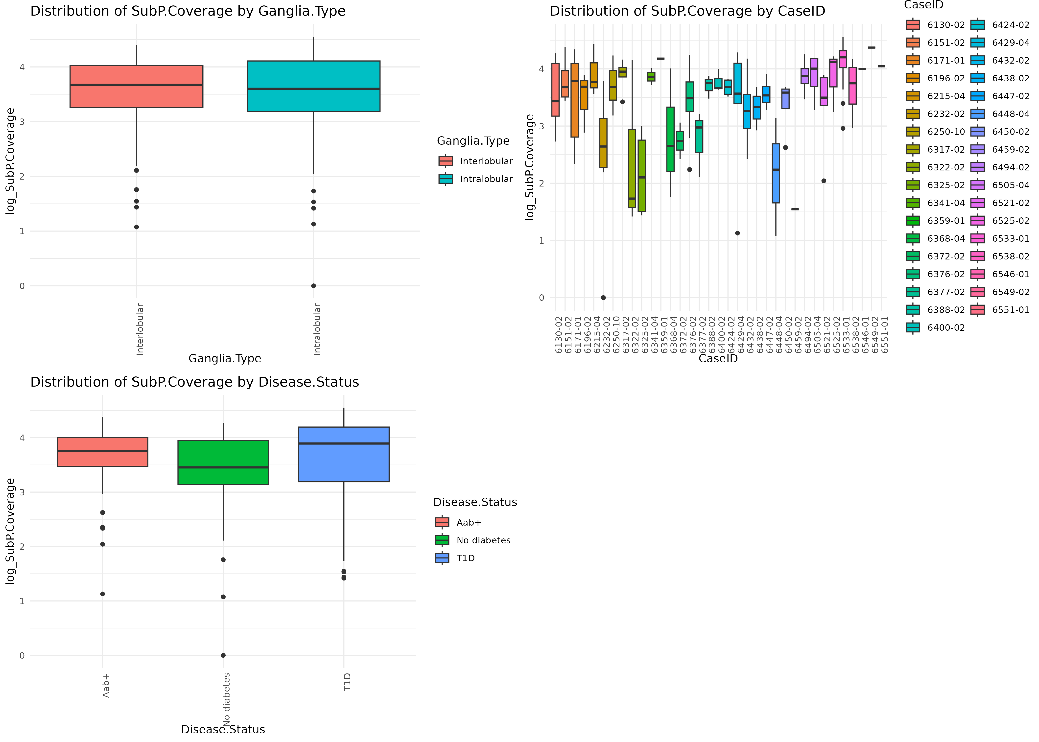

Slide 25
Effect of predictor variables on TH_Coverage

Slide 26
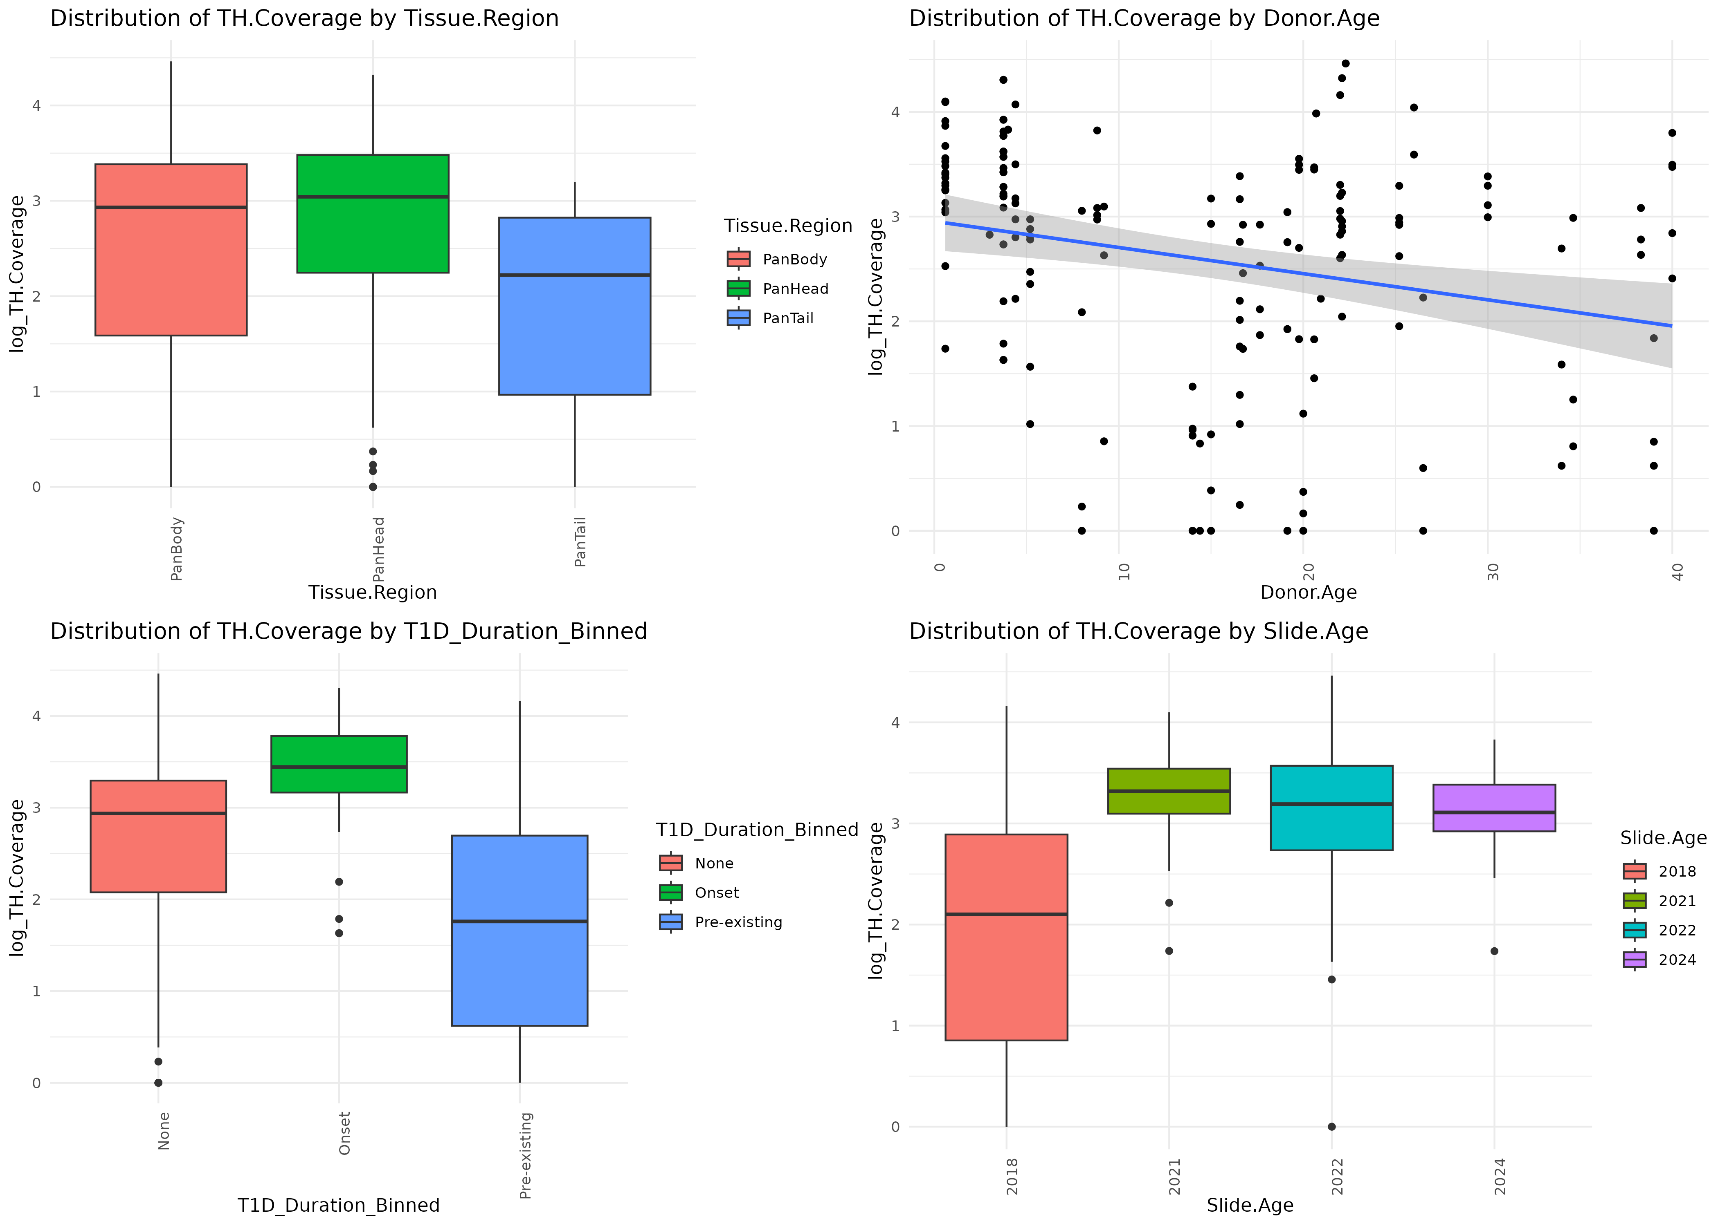

Slide 27
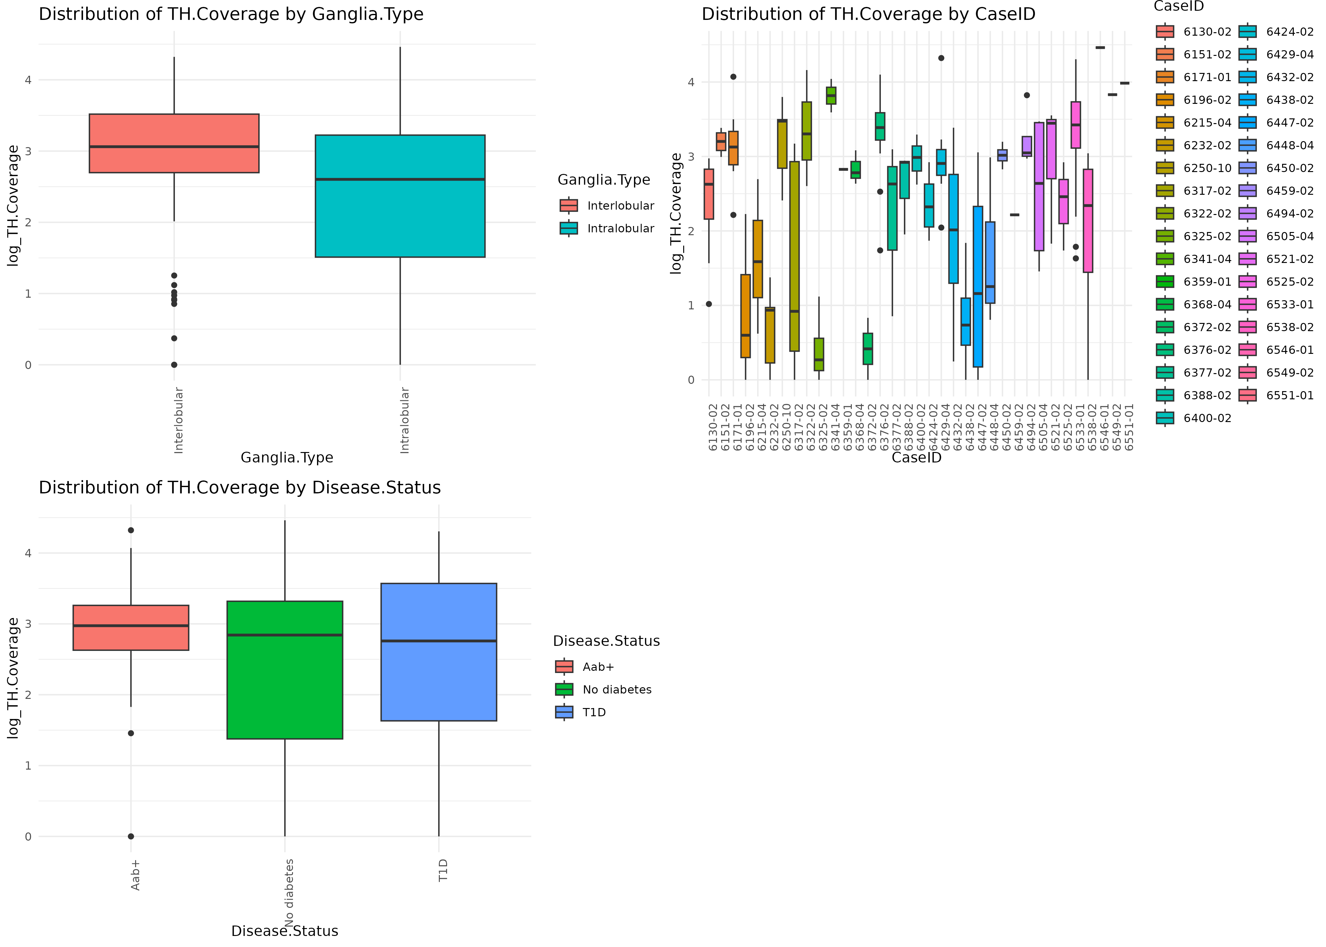

Slide 28
Effect of predictor variables on VIP_Coverage

Slide 29
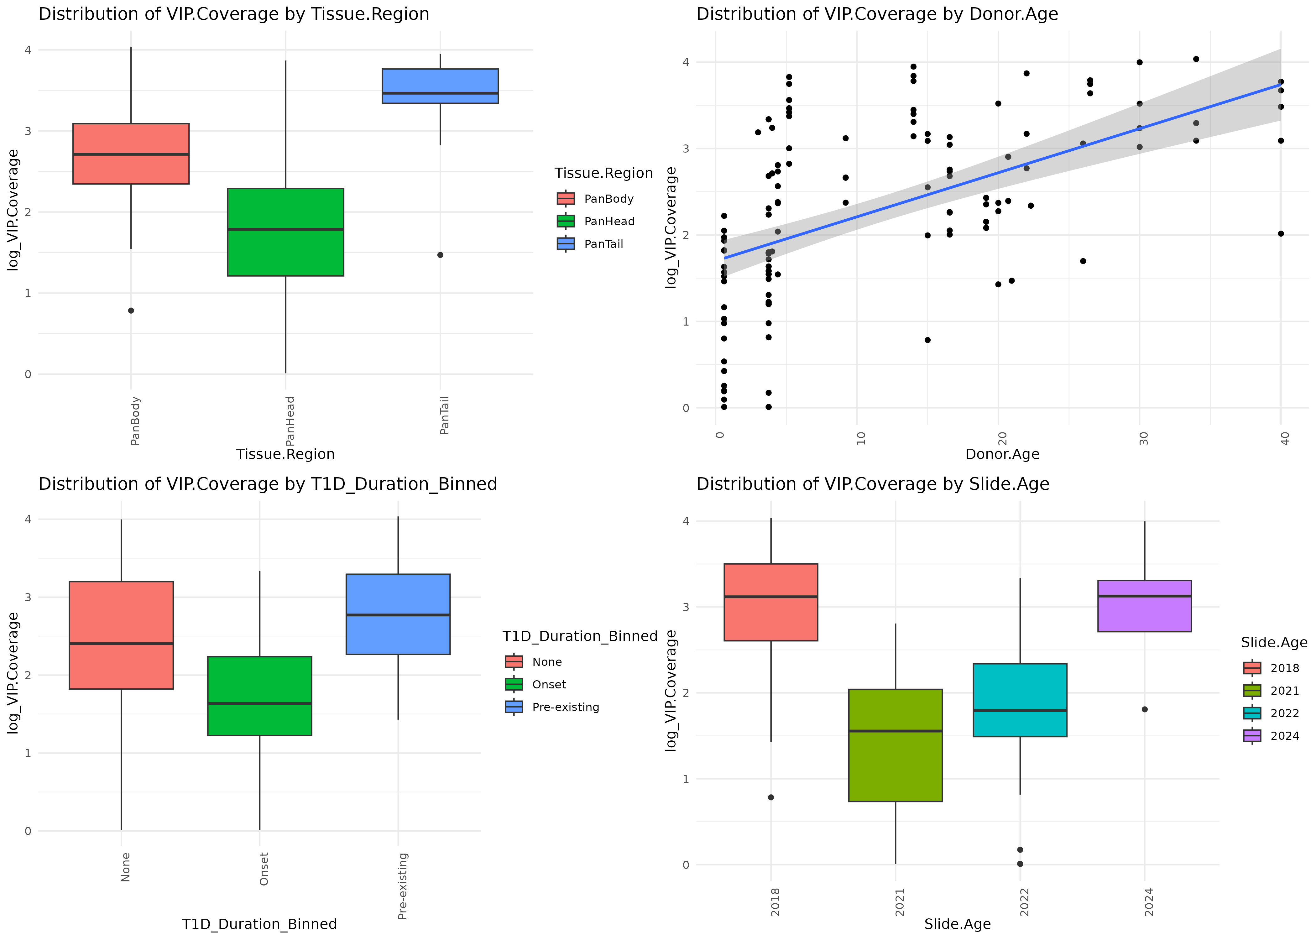

Slide 30
